Slide 1
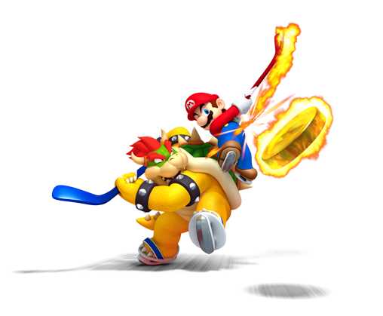
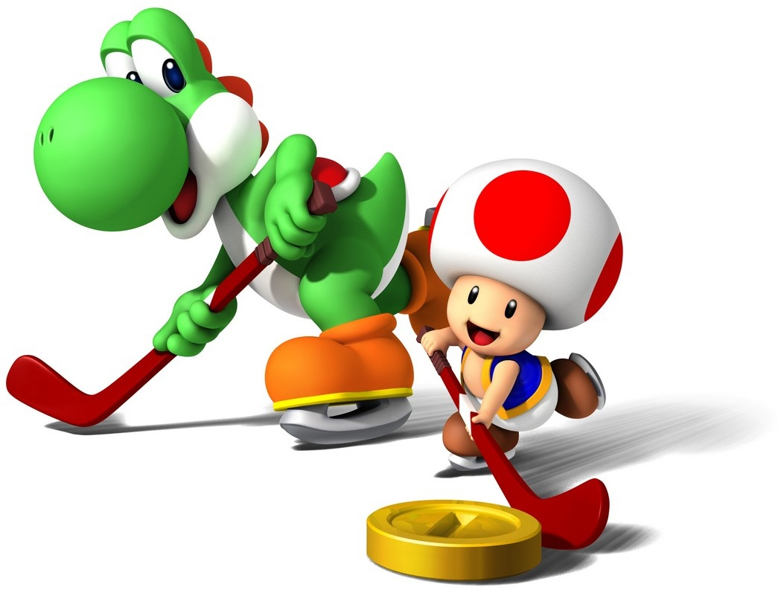
Hockey II
Produced by Dr. Mario | UNC STOR 390

Slide 2

Analyzing Goaltenders
Classic Metrics for Goaltenders
Wins (W)
Goals Against Average (GAA)
Save Proportion (SVP)
Binary Categorization
Considered Optimal

Slide 3
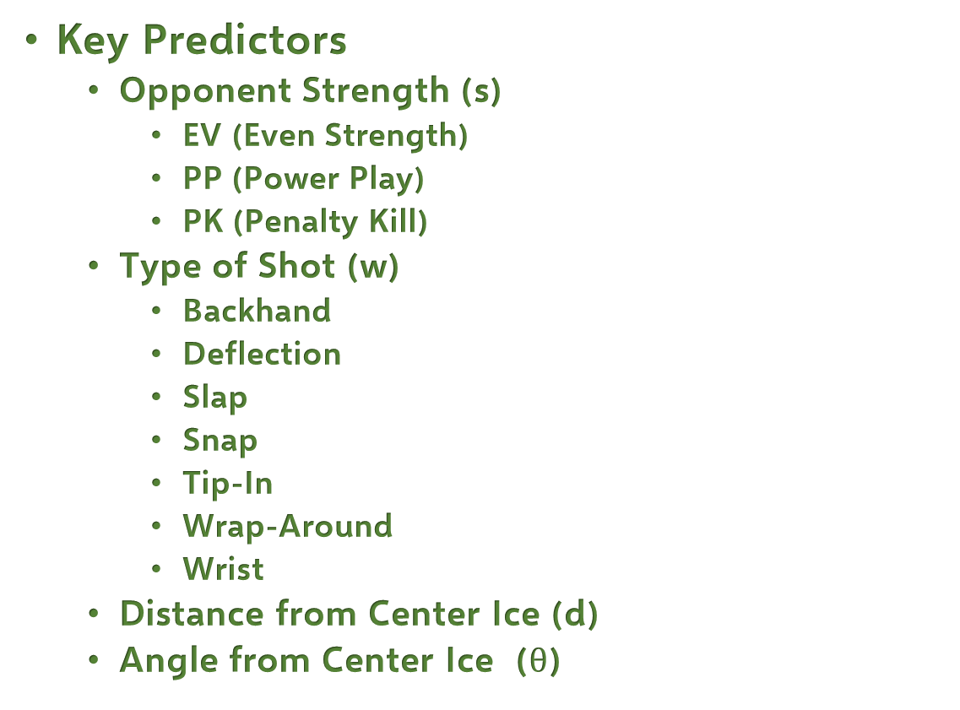
Analyzing Goaltenders
Key Predictors
Opponent Strength (s)
EV (Even Strength)
PP (Power Play)
PK (Penalty Kill)
Type of Shot (w)
Backhand
Deflection
Slap
Snap
Tip-In
Wrap-Around
Wrist
Distance from Center Ice (d)
Angle from Center Ice ($θ$)

Slide 4
Analyzing Goaltenders
Available Data
NHL’S Real Time Scoring System
Measurement Error Exists
Error in Location Detection
R Library nhlscrapr
Metric 1: Wins
Assumes Winning Associated with Goalie Skill
Winning is Team-Dependent

Slide 5


Analyzing Goaltenders
Metric 2: Goals Against Average
Like ERA of Baseball
Average Number of Goals Allowed Per 60 Minutes
Function of SVP, n, and T
Out of Goalie’s Control
Number of Shots
Time Played

Slide 6
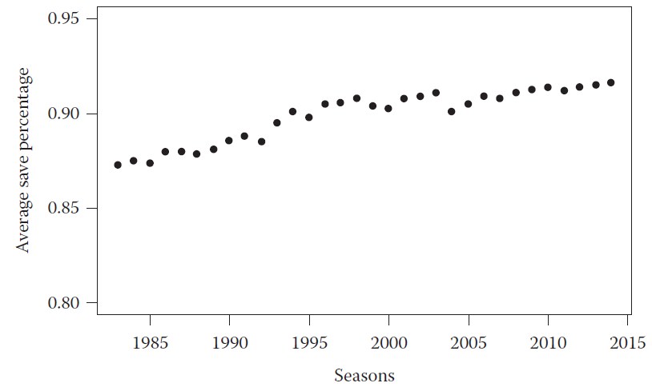



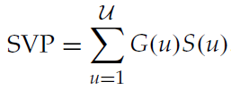
Analyzing Goaltenders
Metric 3: Save Proportion
Estimates Probability Shot Gets in Goal
Moderately Has Been Increasing Over Time
Different Based on State
Decomposed Into Weighted Average
Probability Goalie Saves in State
Probability of Facing Certain State

Slide 7
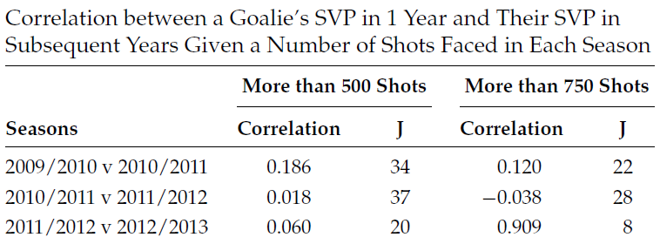
Analyzing Goaltenders
Reliability of SVP

Slide 8
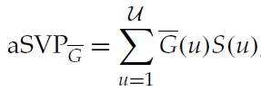
Analyzing Goaltenders
Adjusted SVP
Motivation
Account for Shot Difficulty
Better Prediction of Future Goalkeeper Success
First Version by Ryder (2004)
Save Proportion Relative to What Average Goalie’s Save Proportion Would Be Given the Shots Faced by the Goalie
Compare to SVP
Probability an Average Goalie Saves in State

Slide 9
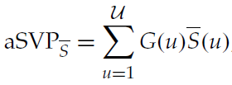
Analyzing Goaltenders
Adjusted SVP
Second Version by War-On-Ice.com (2014)
Save Proportion Relative to An Average Goalie’s Shot Quality
Goalies Are Compared Using Same Shot Distribution
Compare to SVP
Probability an Average Goalie Faces the State

Slide 10


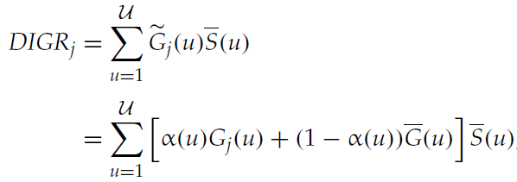
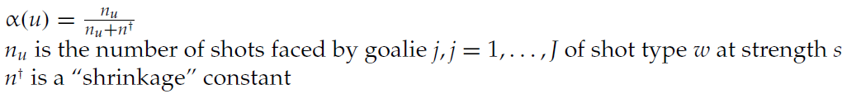
Analyzing Goaltenders
Shot Probability Models
Goal: Estimate Probability a Shot Results in a Goal
Purpose: Estimate Components of Adjusted SVP
Methods: Logistic Regression
Developed by Many Researchers
Defense Independent Goalie Rating

Slide 11
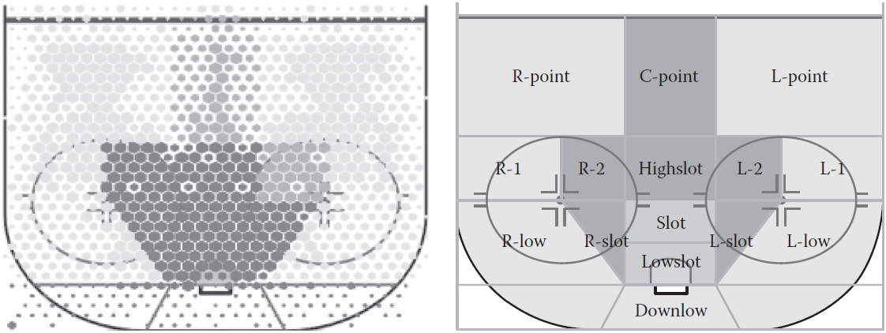
Analyzing Goaltenders
Shot Probability Models
Incorporation of (x,y) Location Relative to Center
Authors Modified Original DIGR
Treated Rebounds/Rush Shots as Separate Types
Used Adjusted Shot Location Based on Rink
Modified Shrinkage Constant for Prediction Accuracy

Slide 12
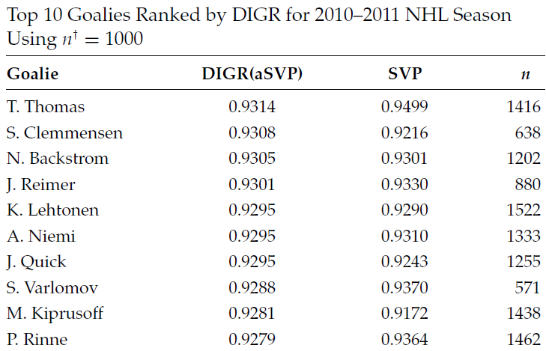
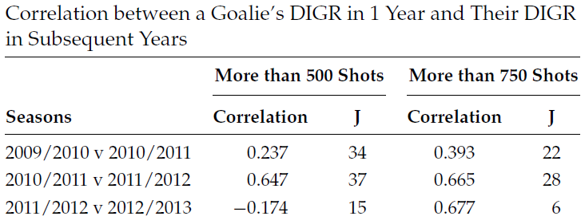
Analyzing Goaltenders
Shot Probability Models
Results of Author’s DIGR

Slide 13
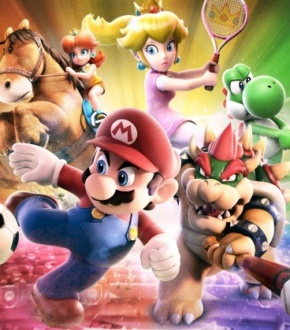
Final Inspiration
I went to a fight
the other night, and a
hockey game broke out.
-Rodney Dangerfield

